Slide 1


Special topics
Session 9
Al-Zahra university
Maryam zim
@maryamzim maryamxiim@gmail.com

Slide 2
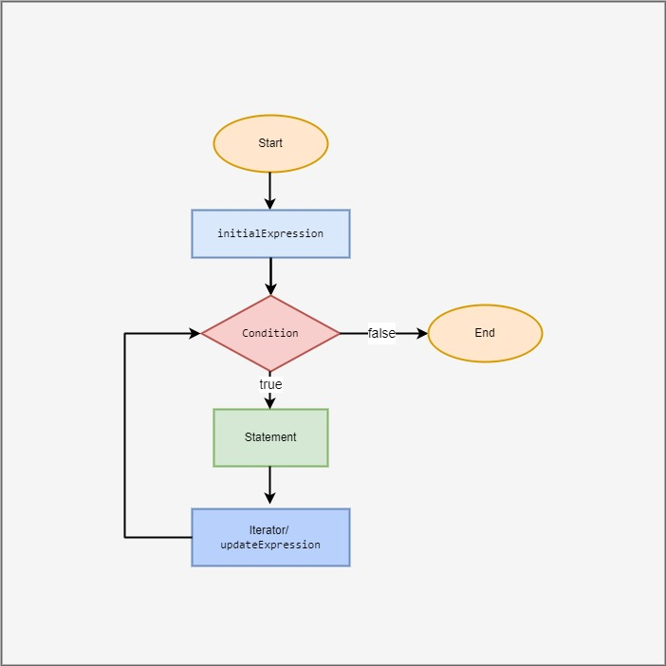
loops :
A loop in JavaScript is a programming structure that allows you to execute a block of code repeatedly based on a certain condition.

Slide 3
Common Types of Loops:
JavaScript provides several types of loops, each suited for different scenarios:
JavaScript has several types of loops for different purposes, which fall into three main categories:
A. Standard Loops
These loops work based on a counter and continue until a condition is true. Like for , while , do..while
B. Iteration Loops
These loops are more modern and efficient for iterating over data structures (such as arrays and objects).like for ... in , for … of.

Slide 4
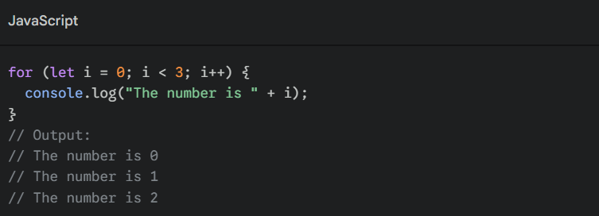
Common Types of Loops:
1. for:
The for loop is the most common type and is best used when you know exactly how many times you want the loop to run.
It has three parts inside the parentheses, separated by semicolons:
1. Initialization: Executed once before the loop starts (e.g., let i = 0).
2. Condition: Checked before each iteration. If it's true, the loop continues; if false, the loop stops (e.g., i < 5).
3. Increment/Decrement: Executed after each iteration (e.g., i++).

Slide 5
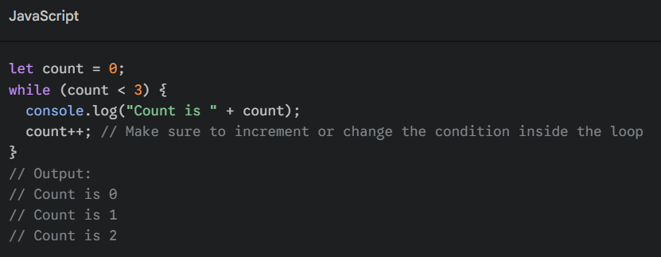
Common Types of Loops:
2. while:
The while loop executes a block of code as long as a specified condition evaluates to true. This is ideal when the number of iterations is not known beforehand, and the loop depends on a dynamic condition.

Slide 6
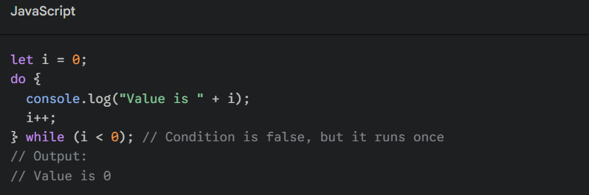
Common Types of Loops:
3. do...while:
The do...while loop is similar to the while loop, but the code block is executed at least once before the condition is checked.

Slide 7
Loop flow control :
Loop flow control in JavaScript refers to the statements you use inside a loop to alter its normal, sequential execution. Instead of letting the loop run naturally until its condition is false, you can use specific keywords to skip an iteration or exit the loop entirely.
1. Break :
The break statement is used to immediately exit a loop structure (such as for, while, do...while, or switch). Once break is encountered, the loop terminates, and program execution continues with the code immediately following the loop.
When to Use It:
When you have found the item you were searching for and don't need to check the remaining items.
When a critical error or condition occurs that makes further iteration pointless or dangerous.
2. continue:
he continue statement is used to skip the current iteration of a loop and immediately jump to the next iteration. When continue is executed, the remaining code within the current loop block is skipped, the loop condition is re-evaluated, and the loop proceeds normally.
When to Use It:
When you want to filter out certain elements or conditions within a sequence without stopping the entire process.
When processing a particular element would cause an error, but you want to safely move on to the next one.

Slide 8
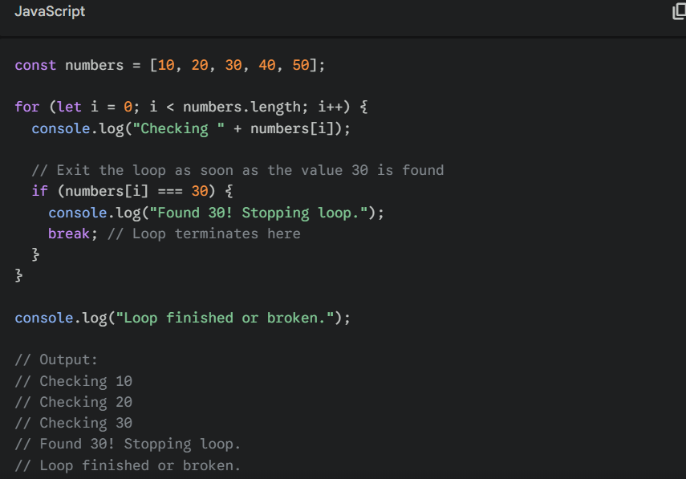
1. Break :

Slide 9
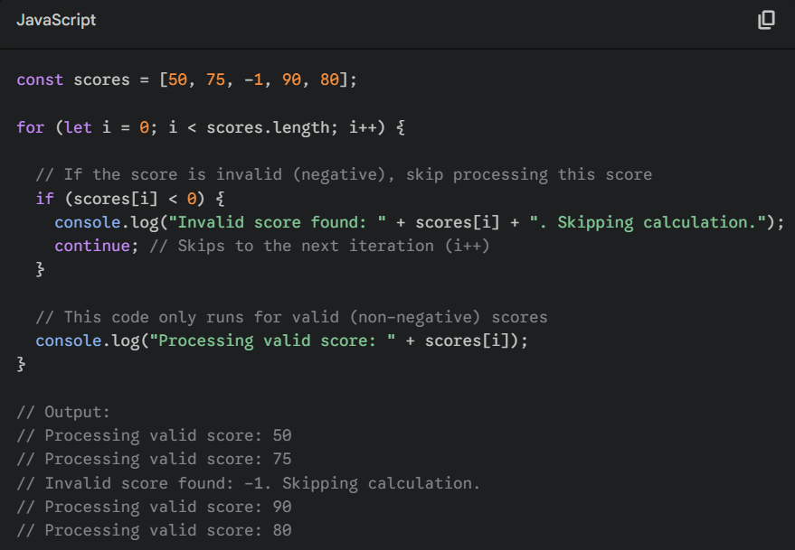
2. continue:

Slide 10
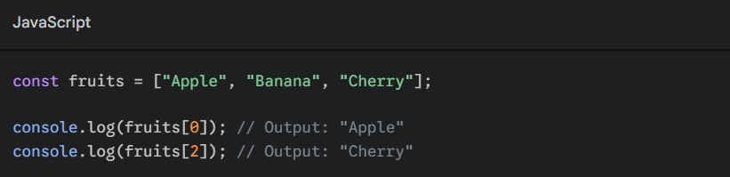
Array:
An Array in JavaScript is a single variable used to store an ordered list of values. These values are called elements, and each element has a specific numerical position, starting from zero, called its index.
Key Characteristics of JavaScript Arrays:
Ordered: The elements maintain the order in which they are placed.
Zero-Indexed: The first element is always at index 0, the second at index 1, and so on.2 If an array has 3$N$ elements, the last element is at index.
Heterogeneous: Unlike arrays in some other languages, a single JavaScript array can hold elements of different data types (e.g., numbers, strings, objects, and even other arrays).6
Creating Arrays:
You use square brackets ([]) to define the array elements.
Accessing Elements:
To get a value, specify its index inside the brackets.

Slide 11
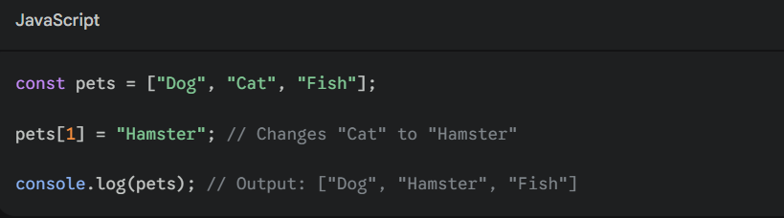
Modifying Elements:
To change a value, assign a new value to the specified index.

Slide 12
Array methods:
Array methods in JavaScript are built-in functions that allow you to easily manipulate, transform, and access the elements of an array.
Array methods can be broadly grouped into categories based on what they do:
Mutator Methods:
These methods change (mutate) the array they are called on.
Like :
Push()
Pop()
Shift()
Unshift()
splice()

Slide 13
Method | Description | Example
.push(element1, ...) | Adds one or more elements to the end of an array and returns the new length. | arr.push('d’) => ['a', 'b', 'c', 'd']
.pop() | Removes the last element from an array and returns that element. | arr.pop() => ['a', 'b']
.unshift(element1, ...) | Adds one or more elements to the beginning of an array and returns the new length. | arr.unshift('x’) => ['x', 'a', 'b', 'c']
.shift() | Removes the first element from an array and returns that element. | arr.shift() => ['b', 'c']
.splice(start, deleteCount, item1, ...) | A powerful method that can add, remove, or replace elements at any position. | arr.splice(1, 1, 'x') => removes 1 element at index 1 and inserts 'x'

